Slide 2
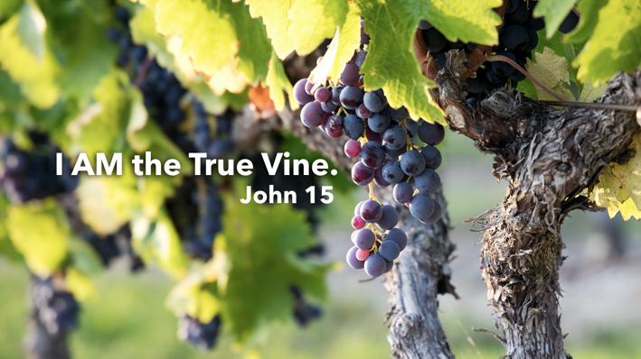

Slide 3
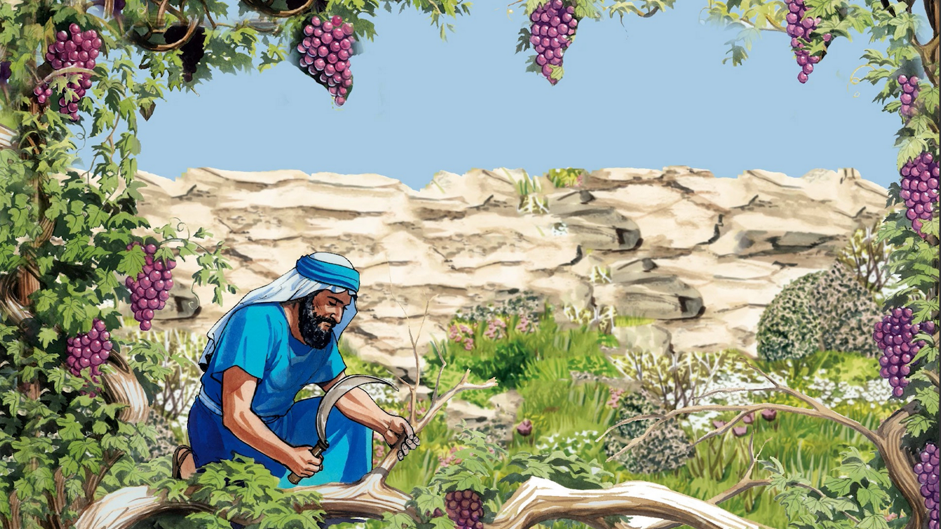
God Is The Vinedresser
One Of The First Occupations-
Noah – Genesis 9:20
Issac – Genesis 26:12,14
Jacob’s Family – Genesis 37:7
"denotes (a) a `husbandman,' a tiller of the ground, 2 Tim. 2:6; Jas. 5:7; (b) `a vinedresser, John 15:1’”
He Cuts Away The Dead Branches – Romans 11:17-23

Slide 4
Christ The True Vine
“real, ideal, genuine” Vine
Vine Tree – well disciplined to obtain fruit with desired quality
Grows On Its Own – seed dispersed randomly, a forest vine
Vine Tree- only allowed branches that are fruitful, trimmed regularly from season to season
Forest Vine – grows wildly; lots of branches, produces bitter fruit
TRUE VINE – implies He is PERFECT vine – Not just ONE OF MANY! UNIQUE!

Slide 5
Life That Is In The Vine…
Is Throughout The Whole Vine – Every Branch
John 14:6 “"I am the way, the truth, and the life. No one comes to the Father except through Me."
Christ is the SOURCE of LIFE - ALL who are IN THE VINE enjoy LIFE in HIM! John 15:1,2
If a BRANCH is CUT OFF the VINE, IT WILL DIE – John 6:63
Words of Life Come From God- John 17:8,20
John 15:7 “abide in Me, and My words abide in you”

Slide 6
“YOU” Are The Branches..
Does NOT Refer to Denominations – refers to collective “HE”s in verse 5 [HE who abides in Me, and I in HIM]
Individuals! Like YOU and ME! Disciples of Christ!
Must Bear Fruit – John 15:4,5 “much fruit”
Good Fruit – Matthew 7:16 "You will know them by their fruits.”
We Cannot Bear Fruit Inconsistent With Nature of Christ and Abide In The Vine! – Acts 2, 8, 9, 10, 11, 26 & 1 Peter 4:16
Everything Else is BAD FRUIT! Proverbs 16:25

Slide 7
Fail to Bear Fruit – Will Be Cut Off and Cast Into The Fire
John 15:2 "Every branch in Me that does not bear fruit He takes away”
John 15:6 “gather them and throw {them} into the fire, and they are burned."
2 Peter 2:20-22 “better for them not to have known the way of righteousness, than having known it, to turn from the holy commandment”

Slide 8
Good Fruit Will Glorify The Vine
John 15:8 “bear much fruit; so you will be My disciples”
Bearing FRUIT is a TEST of DISCIPLESHIP
Philippians 1:19,20 “so now also Christ will be magnified in my body, whether by life or by death.”

Slide 9
Are We Abiding In The True Vine?
Cannot until the Lord has ADDED US to HIS BODY, the CHURCH – Acts 2:47
If we are IN THE VINE, but NOT BEARING FRUIT, chances are the Lord may be ready to PRUNE US!
Romans 11:19-22

Slide 10
Why Not Become A Fruitful Part Of The True Vine Now?

